Slide 1
UNIT IV
Transistor Biasing

Slide 2
Biasing
Transistor biasing is the process of applying external DC voltages and currents to a transistor to set it in the proper operating region (usually the active region) for amplification or switching applications.
Purpose of Biasing
To establish a stable operating point (Q-point):
The transistor must operate in a fixed region of its characteristics to ensure predictable behavior.
To prevent distortion:
Ensures that the input signal varies symmetrically without clipping.
To achieve temperature stability:
Compensates for changes in transistor parameters due to temperature variations.
To ensure proper transistor operation:
Keeps the transistor in the desired region (cut-off, active, or saturation).

Slide 3
Operating Regions of a Transistor
Region | Base-Emitter Junction | Base-Collector Junction | Application
Cut-off | Reverse biased | Reverse biased | Switch OFF
Active | Forward biased | Reverse biased | Amplifier
Saturation | Forward biased | Forward biased | Switch ON

Slide 4
Types of Biasing Circuits (for BJT)
Fixed Bias (Base Bias):
A resistor is connected between the base and supply voltage.
→ Simple but poor stability.
Collector-to-Base Bias (Feedback Bias):
A resistor connects the base to the collector for feedback stabilization.
Voltage Divider Bias (Self Bias):
Uses two resistors (R1, R2) to form a voltage divider at the base.
→ Most stable and widely used.
Emitter Bias (Stabilized Bias):
Uses a resistor in the emitter leg to provide thermal stability.

Slide 5
Transistor Stability
Transistor stability refers to the ability of a transistor biasing circuit to maintain a constant operating point (Q-point) — that is, stable collector current (IC) and collector-emitter voltage (VCE) — despite variations in:
Temperature
Transistor parameters (like β, the current gain)
Power supply voltage (VCC)
A bias circuit with good stability keeps the transistor’s performance unchanged under these variations

Slide 6
Causes of Instability
Temperature rise increases leakage current (ICO).
Variation in β (beta) from one transistor to another.
Change in VBE (base-emitter voltage) with temperature.
The stability of a transistor circuit is measured using stability factors.
These indicate how much the collector current (IC) changes when parameters like ICO, VBE, or β vary.

Slide 7
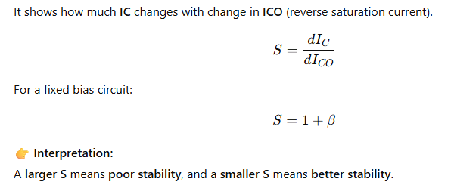
Overall Stability Factor (S)

Slide 8
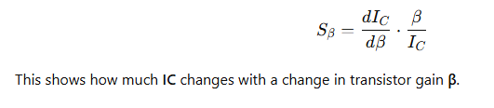
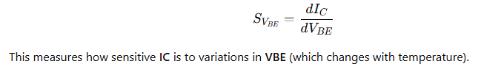
Stability Factor with respect to β
Stability Factor with respect to VBE
Ideal Condition for Perfect Stability:
S=1, that means collector current IC is independent of ICO, β, and VBE — but practically, this is not achievable.

Slide 9
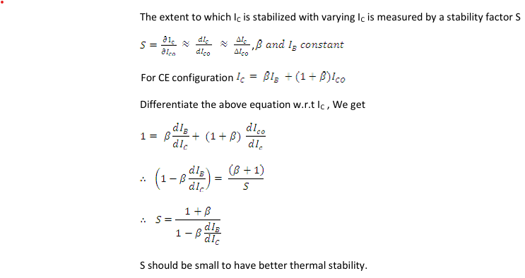

Slide 10
DC Load Line
The DC load line is a straight line drawn on the transistor’s output characteristics (IC vs VCE curve) that represents all possible combinations of collector current (IC) and collector-emitter voltage (VCE) for a given DC biasing circuit.
It shows how the transistor behaves under DC conditions (no input signal), based on the supply voltage and circuit resistances.
The DC load line is a graphical representation of all possible values of IC and VCE determined by the external resistors and supply voltage in a transistor circuit.
It helps in locating the operating point (Q-point) for proper transistor operation.

Slide 11
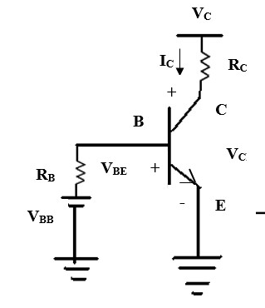
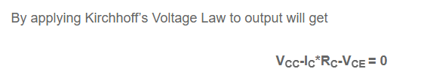

Slide 12
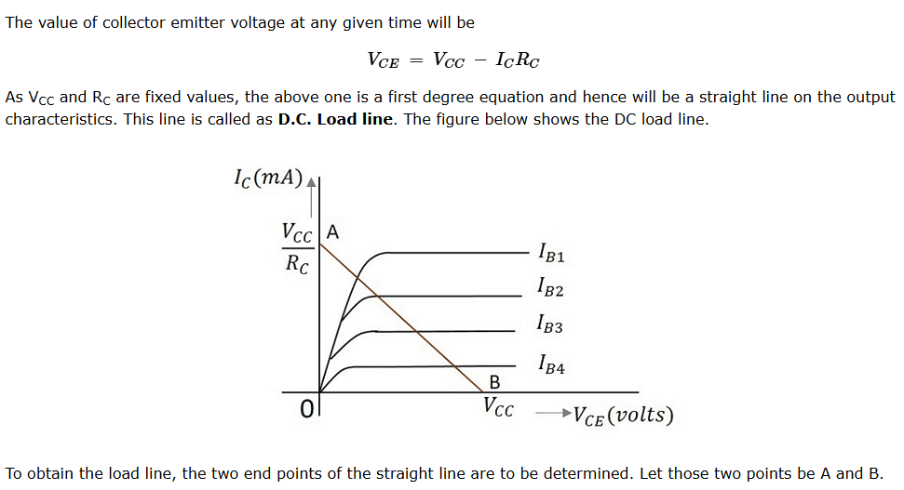

Slide 13
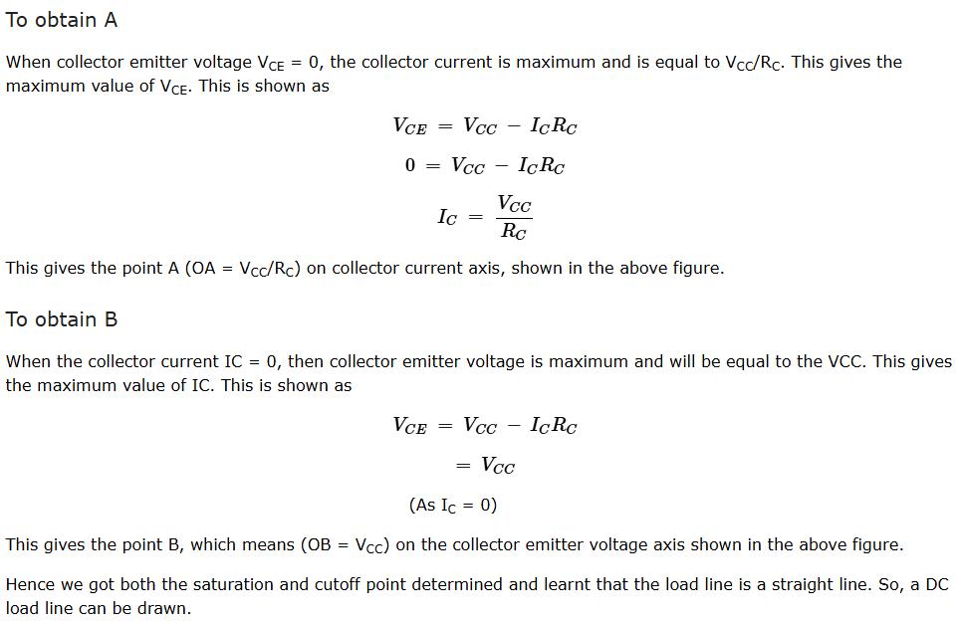

Slide 14
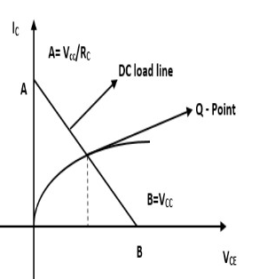
Q-Point (Quiescent Point)
The Q-point is plotted on the DC load line by determining the operating conditions of the transistor and marking the corresponding IC​ and VCE​ values on the graph.
The Q-point is plotted on the DC load line by determining the operating conditions of the transistor and marking the corresponding IC​ and VCE​ values on the graph.
Purpose of Q-Point
Defines the transistor’s operating region (active, cutoff, or saturation).
Ensures faithful amplification — signal should not distort or clip.
Maintains thermal stability during operation.

Slide 15
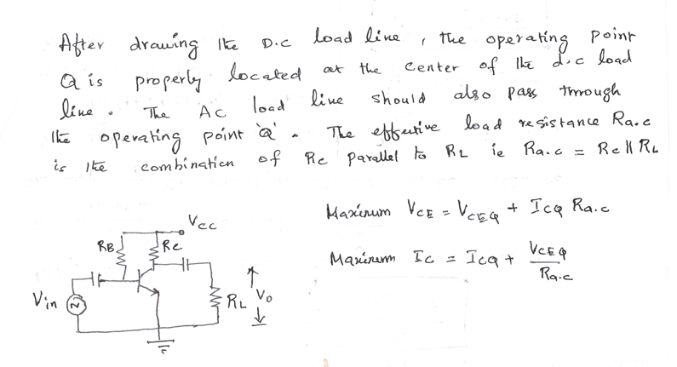
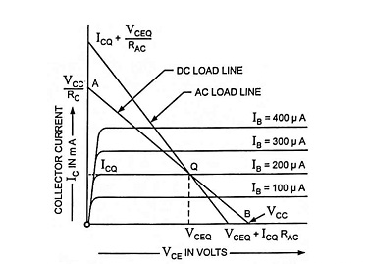
AC Load Line

Slide 16
Factors Affecting the Operating Point
The point obtained on the dc load line by the value I_{c} and V_{CE} when no signal is applied at the input is known as operating point.
The following are the factors that affect the stability of the operating point
Temperature dependence of I_{C} .
Change of V_{BE} and β due to replacement of transistor.
Thermal runway.

Slide 17
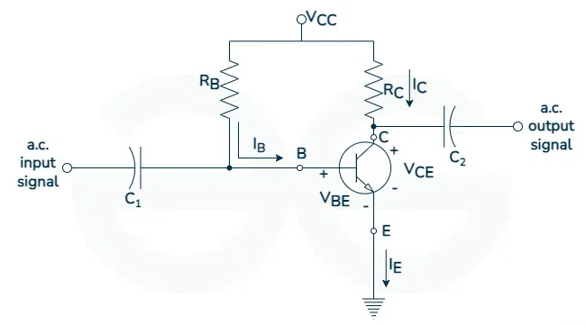
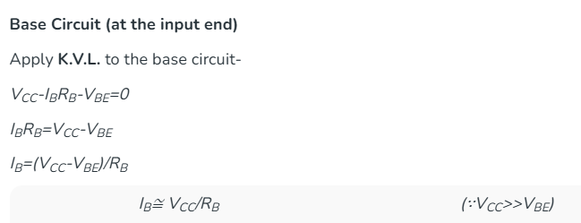
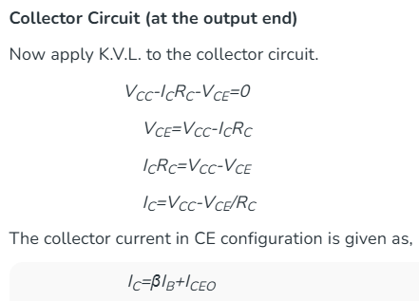
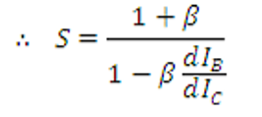



Fixed Bias
In this, a resistance R_{B} is connected between supply V_{CC} and base terminal of the transistor. The required zero signal base current I_{B} is provided by V_{CC} and a single V_{CC} keeps the base emitter junction forward biased and the collector base junction reverse biased.
Stability Factor S is independent of current Ic, therefore =0

Slide 18
Advantages of Fixed Biased Circuit
It is a simple circuit.
The operating point can be fixed anywhere in the active region of the characteristics by simply changing the value of R_{B}.
Biasing conditions are set easily.
No loading effect as no resistor is present at base-emitter junction.
Due to their simplicity fixed bias circuits are cost effective.
Disadvantages of Fixed Biased Circuit
Poor thermal stability.
Since I_{C}=βI_{B} is already fixed. I_{C} depends on β which is different for same type of transistor and shifts the operating point.
Adjusting the operating point over a wide range may be challenging with fixed bias, limiting its suitability for certain applications.
Potential for thermal runaway.
Limited temperature compensation leads to changes in bias point.

Slide 19
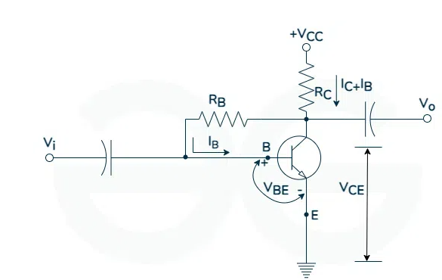
Collector to Base Bias
In this, one end of R_{B} resistor is connected to the base and the other end to the collector. here, the base current is not determined by V_{CC}.
Base Circuit: Apply K.V.L. to it:
V_{CC}=(I_{C}+I_{B})R_{C}+I_{B}R_{B}+V_{BE}
V_{CC}=I_{C}R_{C}+I_{B}R_{C}+I_{B}R_{B}+V_{BE}
But I_{C}=βI_{B},
∴ V_{CC}=βI_{B}R_{C}+I_{B}R_{C}+I_{B}R_{B}+V_{BE}
V_{CC}=I_{B}[(1+β)R_{C}+R_{B}]+V_{BE}
∴ I_{B}=(V_{CC}-V_{BE})/{(1+β)R_{C}+R_{B}
Collector Circuit
Apply K.V.L. to this circuit,
V_{CC}=(I_{C}+I_{B})R_{C}+V_{CE}
V_{CC}=I_{C}R_{C}+I_{B}R_{C}+V_{CE}
∴ V_{CE}=V_{CC}-(I_{C}+I_{B})R_{C}
I_{C}=βI_{B}
∴ I_{C}=β[(V_{CC}-V_{BE})/(1+β)R_{C}+R_{B}

Slide 20
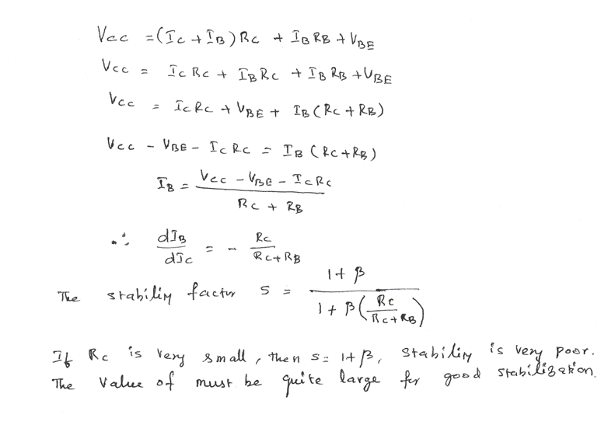
Stability factor of Collector to Base Bias

Slide 21
Advantages of Collector to Base Bias Circuit
It is a simple circuit. It provides some stabilization of the operating point.
It needs only one resistor at base.
Reduced sensitivity to transistor variations.
Lower sensitivity to the power supply changes.
Disadvantages of Collector to Base Bias Circuit
It does not provide good stabilization because stability factor is high.
It provides a negative feedback which reduce the gain of the amplifier.
Dependency on component matching.
More complex in comparison to fixed bias circuits.
Restricted utilization in certain application with specific voltage requirements.

Slide 22
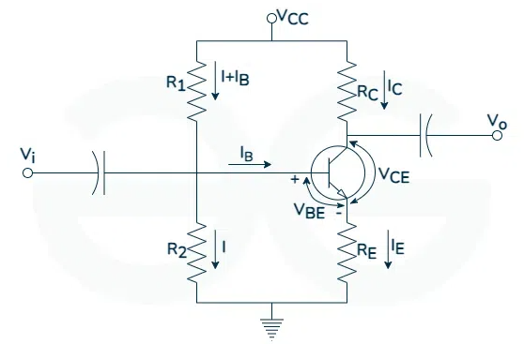
Voltage Divider Bias or Self Bias or Universal Bias
The voltage divider is formed by R₁ and R₂. The voltage drop across R₂ forward biases the base emitter junction.
The R₁ and R₂ resistor act as a voltage divider giving a fixed voltage at point B which is base. This is the most widely used biasing method that provides biasing and stabilization to a transistor.
Base Circuit: Voltage across R₂ is the base voltage V_{B}.
Apply voltage divider to this circuit
∴ V_{B}=(V_{CC}R₂)/(R₁+R₂)
Collector Circuit: Voltage across R_{E} is V_{E} and can be obtained as
V_{E}=I_{E}R_{E}=V_{B}-V_{BE}
I_{E}=(V_{B}-V_{BE})/(R_{E})
Apply K.V.L.
V_{CC}=I_{C}R_{C}+V_{CE}+V_{E}
V_{CE}=V_{CC}-I_{C}R_{C}-I_{E}R_{E}

Slide 23
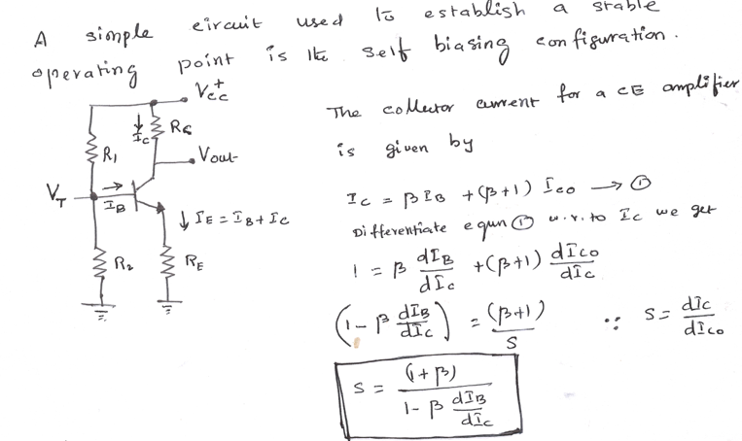

Slide 24
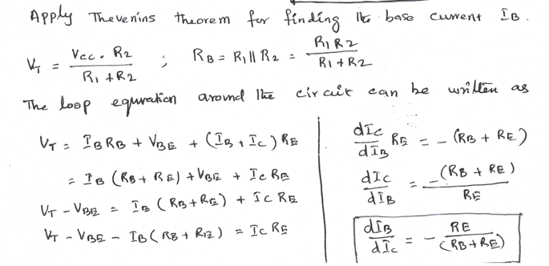
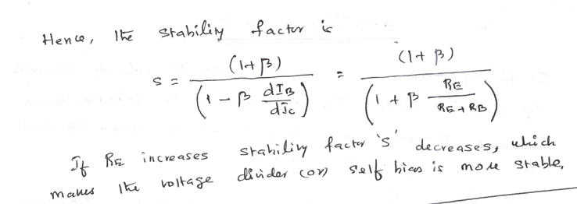

Slide 25
Advantages of Voltage Divider Base Circuit
I_{C} in this circuit is almost independent of transistor parameters.
The resistor employed in the emitter provides stabilization.
It is the most prominent one.
Flexibility in adjusting operating point.
Moderate sensitivity to power supply changes.
Disadvantages of Voltage Divider Base Circuit
The signals tend to get mixed up.
It requires more components.
Due to the increased complexity, it tend to be more expensive.
It can lead to reduction in overall circuit efficiency due to the power dissipation.
Dependency on component matching.

